Slide 1
Making visual choices that enhance learning
Karla Ramirez • Caty Medrano

Slide 2
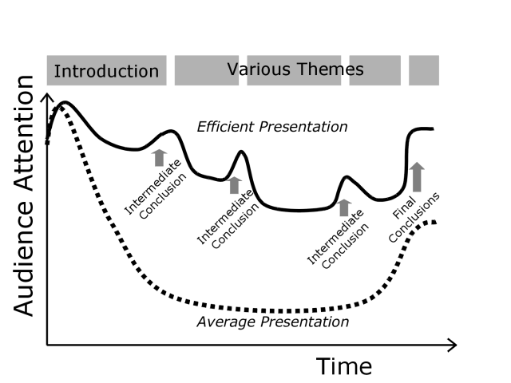
The attention span problem
Source: efp.org

Slide 3
Our test subject

Slide 4
On colors

Slide 5
No more than 5 colors
Solid colors are your friends

Slide 6
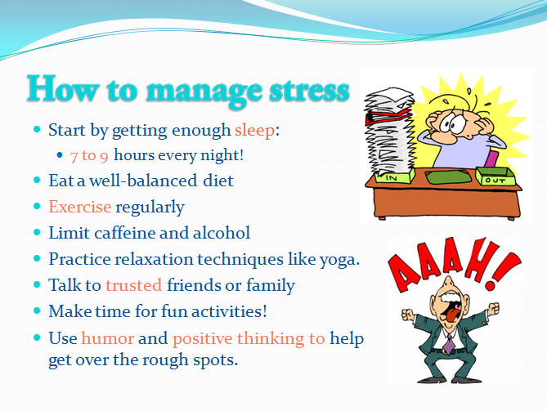
Use contrast on key words
Avoid colors on the same scale

Slide 8
On Text

Slide 9
Don’t use more than 8 lines of text
Split the presentation into more slides if necessary

Slide 10
Try to use sans-serif fonts
Size fonts appropriately
F
F

Slide 11
Try to use sans-serif fonts
Size fonts appropriately
Constantia
Corbel

Slide 12
On Graphics

Slide 13
Use high-quality graphics
Limit graphics to one per slide

Slide 14
General tips

Slide 15
Think about layout
Use the rule of thirds

Slide 16
Think about layout
Use the rule of thirds

Slide 17
Fonts can be fun too
Help titles be more contrasting

Slide 18
The “Power” in PowerPoint
Tips to make your life easier
To do this | Press
Start a presentation from the beginning | F5
Go to slide number | (Number of slide) + ENTER
Display a blank white slide, or return to the presentation from a blank white slide | W or COMMA
Return to the first slide | Press and hold Right and Left Mouse buttons for 2 seconds
Show or hide arrow pointer | A or =
Change the pointer to a pen | CTRL + P
Play or pause a video | ALT + P
Increase sound volume | ALT + Up
Decrease sound volume | ALT + Down

Slide 19
Resources

Slide 20
For graphics
Flickr.com: images that have a Creative Commons license
http://compfight.com/
Creative Commons search: search several sites for various media, all licensed with Creative Commons.
http://search.creativecommons.org/
Medical Stock images and footage: Medical focused repositories of free and commercial stock images.
http://www.nlm.nih.gov/services/stockshot.html

Slide 21
For fonts and color design
Adobe Kuler: online dynamic color wheel
http://color.adobe.com/create/color-wheel/
Google fonts: web-friendly fonts that are licensed for re-use
https://www.google.com/fonts
Fontpair: See which fonts go together nicely
http://fontpair.co/

Slide 22
…if all else fails
Prezi: online presentation software
http://prezi.com/
Slides Carnival: free and commercial PowerPoint templates
http://www.slidescarnival.com/category/free-templates

