Slide 1
School of Nursing
Phase 2

Slide 2
Fall 2021 Phase 3
Ranking Timeline
Date | Process
Monday, August 16, 2021 | Ranking takes place in the a.m. Selection e-mails will be sent in the p.m. Refrain from calling or e-mailing so that we complete the ranking in a timely manner.
Tuesday, August 17, 2021 | Registration Ranking for Phase 2 repeaters Phone calls to selected Phase 2 repeaters
Wednesday, August 18, 2021 | Phase 3 registration deadline at noon
Thursday and Friday, August 19-20, 2021 | Red Carpet Orientation for Phase 3 selected students
Monday, August 23, 2021 | Fall 2021 Classes start

Slide 3
Phase 3 Ranking Criteria
Criterion 1 | Phase 2 Nursing Courses GPA (highest grade per attempt will be used)
Criterion 2 | Pre-professional Courses (PPC) GPA
Criterion 3 | Overall GPA (minimum GPA to apply is 3.00)
Criterion 4 | TEAS Test (minimum score of 62%) Ensure that your TEAS score is up to date Your TEAS score is valid for 2 years—check your ATI account for your test date(s)

Slide 4
Fall 2021 Phase 2 Repeat Ranking Timeline
Required: Phase 2 Course Repeat Form
UTEP.edu/nursing (Resources/Forms & Handbooks)
Ranking: Tuesday, August 17, 2021
Phone calls to selected students
Registration for selected students
Resubmit CBC information form if selected
Submit proof of health insurance if selected
Deadline to submit form: Friday, August 13, 2021
Second attempt is the final attempt to continue in the School of Nursing

Slide 5
Ranking Criteria for Repeaters
Tier 1 | Students who completed all 3 Phase 2 courses with a grade of “C” or better will be ranked first using the following criteria. Phase 2 GPA PPC GPA Minimum overall GPA to apply—3.00 Minimum TEAS score to apply—62%
Tier 2 | If open seats remain after Tier 1 ranking takes place then the School of Nursing will conduct a lottery for the remaining seats. Students who withdrew or failed one or more of the Phase 2 courses will be included in the lottery. All students must meet the minimum overall GPA (3.00) and minimum composite TEAS score (62%) to be eligible for the lottery.
Required | Students will be required to submit a Course Repeat Form if they wish to retake one or more of the Phase 2 courses.
Quality - We deliver the highest value in education and research
Service - Through caring, competency and efficiency we provide highest level of customer experience
Communication - By hardwiring our processes we transfer information and knowledge
Accountability - We strive for excellence in everything we do
Ethics - We demonstrate highest level of human conduct and moral principles

Slide 6
Overall GPA
If you do not have an established UTEP GPA
This is your first semester at UTEP.
Your EPCC GPA and your UTEP GPA are “not combined.”
Scenario 1: If you earn all C’s in Phase 2, then your UTEP GPA at the end of the semester will be 2.00
Scenario 2: If you earn an A and two D’s, then your overall GPA at the end of the semester will be 1.75 (Academic Probation)

Slide 7
Overall GPA
If you have an established UTEP GPA of 3.00
Your UTEP overall GPA is calculated by adding up all the grade points you have earned and dividing by the total amount of credits hours earned.
Scenario 1: If you earn all C’s in Phase 2, then your UTEP GPA at the end of the semester will be less than 3.00 (minimum GPA of 3.00 is required to apply to Phase 3).
Scenario 2: If you earn an A and two C’s, then your overall GPA at the end of the semester will be at risk of being less than 3.00.
To maintain a GPA of 3.00, you must earn a minimum Phase 2 GPA of 3.00 (all Bs).

Slide 8
Drop Deadline
Tentative Date
Friday
August 6, 2021
To drop a course, e-mail records@utep.edu from your Miners e-mail with the following information:
Your full name and student ID
Course name (i.e. NURS 2407)
Course CRN (i.e. CRN#25241)

Slide 9
Before you drop
Be aware of the implications dropping a course can have on your financial aid, scholarship, VA benefits eligibility.
Financial Aid
Military Student Success Center
Office of Scholarships
Tuition Assistance Programs

Slide 10
Office of Student Affairs
Make an appointment with one of the academic advisors.
Will assist with GPA calculations and what-if-analysis
Explain the retake policy
Will assist in completing appropriate forms.

Slide 11
Student’s Responsibilities
Be proactive.
Discuss with instructor(s) any issues affecting your performance in class.
Listen to all lectures.
Read your book. Use all of your resources to do well in the Phase 2 courses.
Think long term. Your future career is at stake.
Dropping a Phase 2 course is the student’s decision to make.

Slide 12
Academic Integrity
Being accountable for acting honestly and ethically in all aspects of your academic life.
School of Nursing Honor Code Pledge—”I pledge to not only adhere to the highest ethical standards but to also report any violations of the honor code.”
Collusion is the unauthorized collaboration with others to commit a violation of any provision of the rules of academic dishonesty, including disclosing and/or distributing the contents of an exam.
Example: Discussing test banks and buying class notes on WhatsApp.
Students committing academic dishonesty will be referred to the Office of Student Conduct and Conflict Resolution (OSCCR).

Slide 13
Important Deadlines & Procedures
Nursing Student Affairs sent an e-mail with subject line Summer 2021 Phase 2 Information on Monday, March 22, 2021 at 11:56 a.m.
There is a link to schedule your fingerprint appointment with Identogo.
To apply to Phase 3, send an email to nursing@utep.edu.
E-mail your questions, blue card, and proof of insurance to nursing@utep.edu.
Always include your full name and student ID number when sending an e-mail to nursing@utep.edu.
Deadline to submit your blue card/outcome letter and proof of insurance is Friday, July 30, 2021.
Last day to have blood drawn for titers is Friday, July 30, 2021.
Save your lab report to your One Drive account and share with Pete Rodriguez (pjrodriguez@utep.edu) by Friday, August 6, 2021.

Slide 14
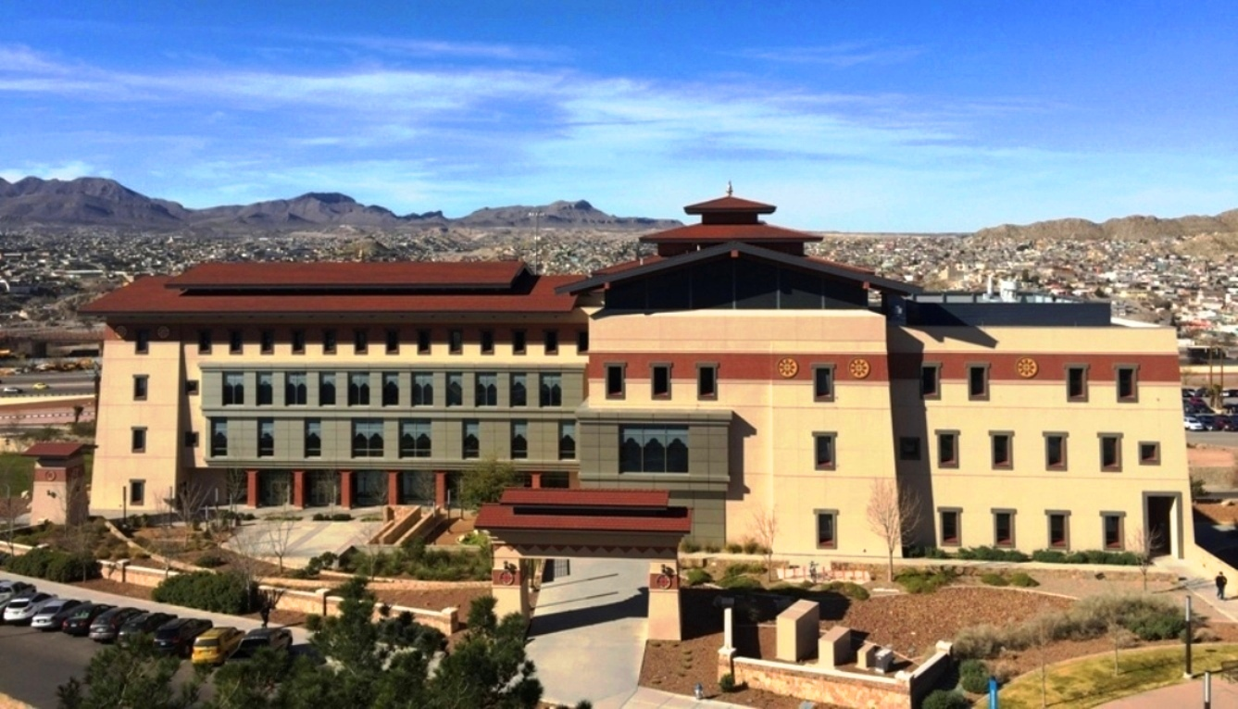
QUESTIONS ???
HAVE A SUCCESSFUL SEMESTER!

